Slide 1

MOUSE LOGITECH M705
an assignment of Computer Aided Design Laboratory M
Università di Bologna
Dipartimento di Ingegneria Industriale

Slide 2
Università di Bologna
MOUSE LOGITECH M705
Dipartimento di Ingegneria Industriale
an assignment of Computer Aided Design Laboratory M
Choice of the assignment’s topic
Some reasons which brought me to choose my computer’s mouse as the object of the assignment
Shape
It has a complex shape that involves a modelling difficulty at least equal to the once of assignments done during the course
Assembly
It is made up of a lot of pieces, which are enough to create an assembly
Portability
It is easily transportable to be always available for taking measurements and comparing the CAD model with the real object

Slide 3
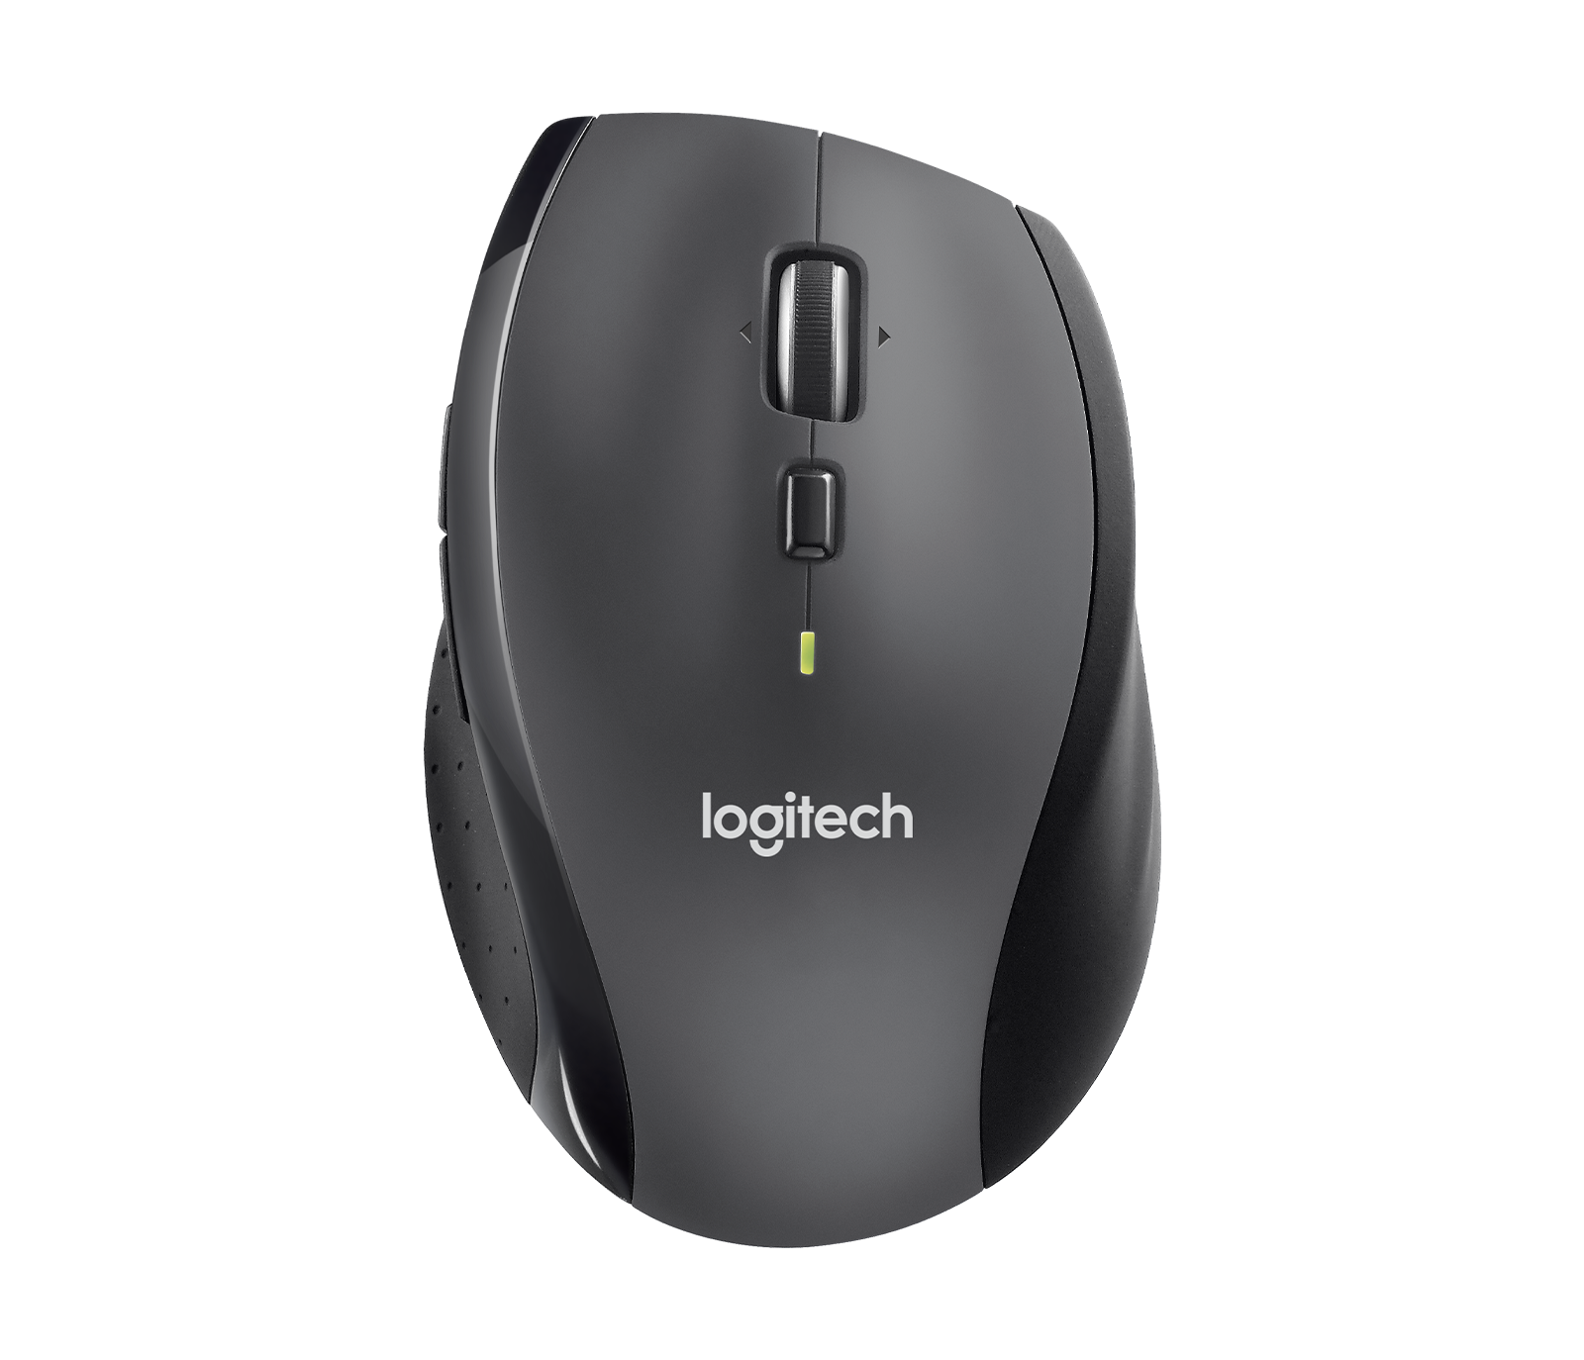

Università di Bologna
MOUSE LOGITECH M705
Dipartimento di Ingegneria Industriale
an assignment of Computer Aided Design Laboratory M
Notable features
Logitech M705
The choice of the project's topic is also justified by the features that the mouse has
Sculpted for comfort
The full-sized contoured shape follows the natural curve of hand for more comfort
Five editable buttons
Hyper fast scrolling
Choice of the assignment’s topic

Slide 4

Università di Bologna
MOUSE LOGITECH M705
Dipartimento di Ingegneria Industriale
an assignment of Computer Aided Design Laboratory M
Notable features
Logitech M705
The choice of the project's topic is also justified by the features that the mouse has
Sculpted for comfort
Sculpted for comfort
The full-sized contoured shape follows the natural curve of hand for more comfort
Two thumb controls and three movements of the mouse wheel
Five editable buttons
Five editable buttons
Hyper fast scrolling
Choice of the assignment’s topic

Slide 5
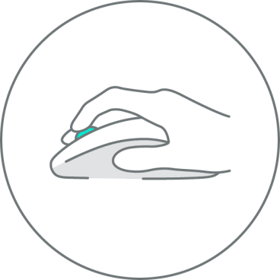
Università di Bologna
MOUSE LOGITECH M705
Dipartimento di Ingegneria Industriale
an assignment of Computer Aided Design Laboratory M
Notable features
Logitech M705
The choice of the project's topic is also justified by the features that the mouse has
Sculpted for comfort
Five editable buttons
Five editable buttons
Two thumb controls and three movements of the mouse wheel
Dual-mode scrolling allows switching between fast and precise scrolling
Hyper fast scrolling
Hyper fast scrolling
Choice of the assignment’s topic

Slide 6
Università di Bologna
MOUSE LOGITECH M705
Dipartimento di Ingegneria Industriale
an assignment of Computer Aided Design Laboratory M
Modelling strategy
Start modelling as a single block
Partition of the single block
The modelling strategy is based on working firstly with a solid single-piece model of the mouse and then subdividing it into several pieces
Further partitions of the block
Detailed modelling of pieces obtained
Addition of other components
Export rendered immages

Slide 7
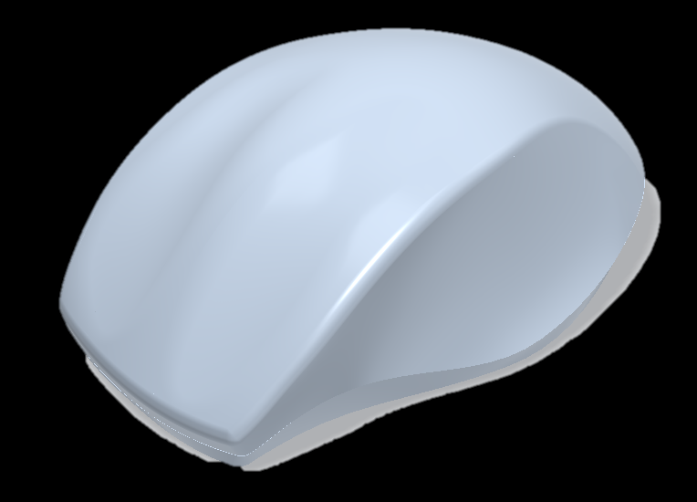
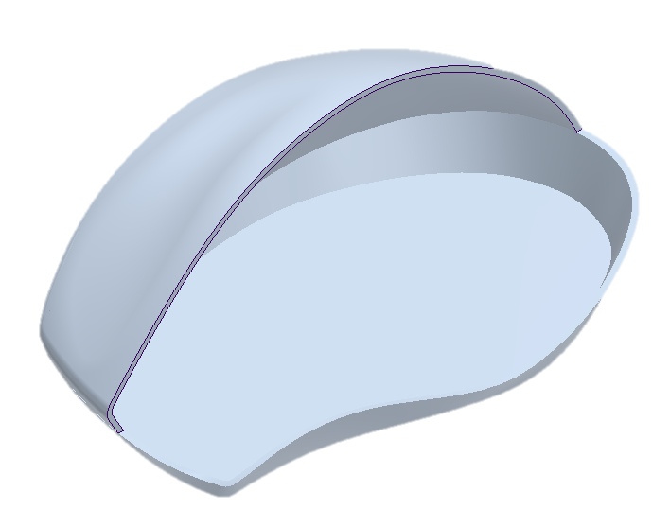
Università di Bologna
MOUSE LOGITECH M705
Dipartimento di Ingegneria Industriale
an assignment of Computer Aided Design Laboratory M
Modelling steps
Start modelling as a single block
Modelling of the starting block
Partition of the single block
The modeling process starts with making a solid monoblock which will establish the basis for following operations
The modelling strategy is based on working firstly with a solid single-piece model of the mouse and then subdividing it into several pieces
Further partitions of the block
Detailed modelling of pieces obtained
Addition of other components
Export rendered immages
Starting from the monoblock, the shell feature removes material leaving a layer of known thickness
Shell feature
Modelling strategy

Slide 8
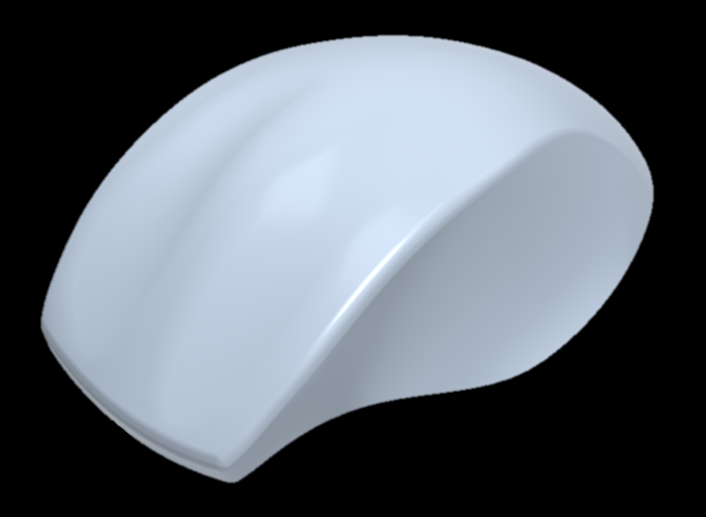
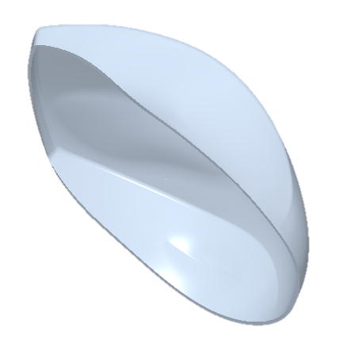
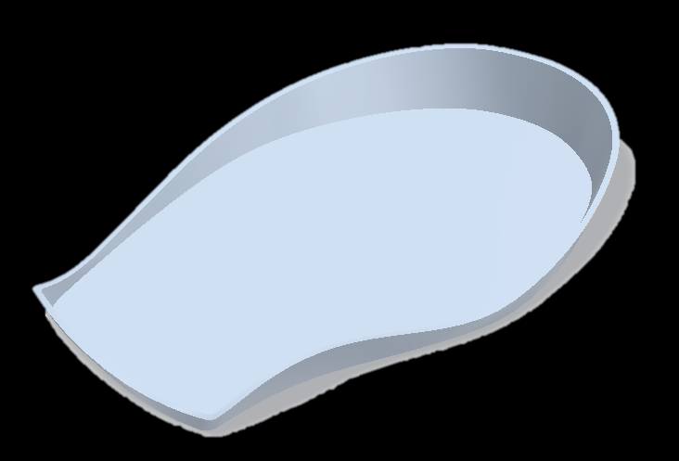
Università di Bologna
MOUSE LOGITECH M705
Dipartimento di Ingegneria Industriale
an assignment of Computer Aided Design Laboratory M
Modelling steps
Partition of the single block
Partition of the monoblock to create the bottom and the top sides of the mouse
The boolean operations feature allows subdividing the shell into two parts through an intermediate boundary surface
Boolean operations
Modelling strategy

Slide 9
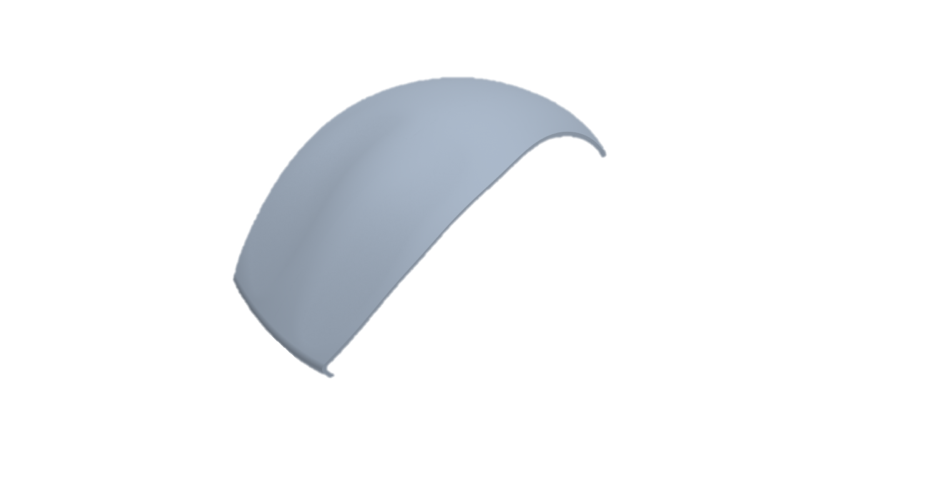
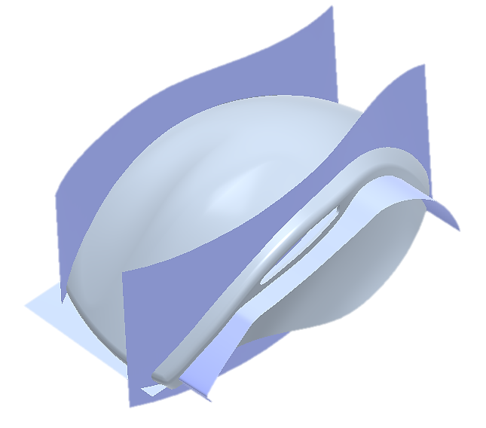
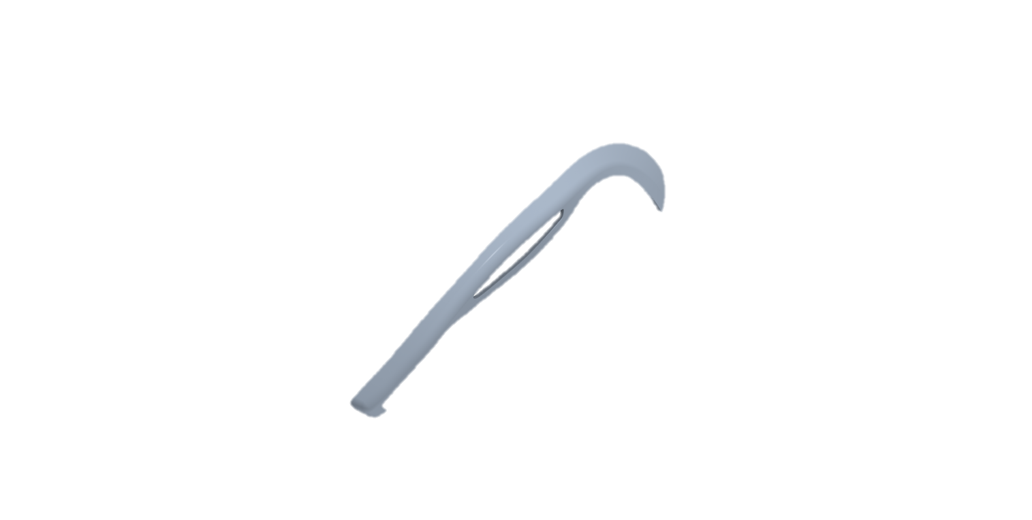
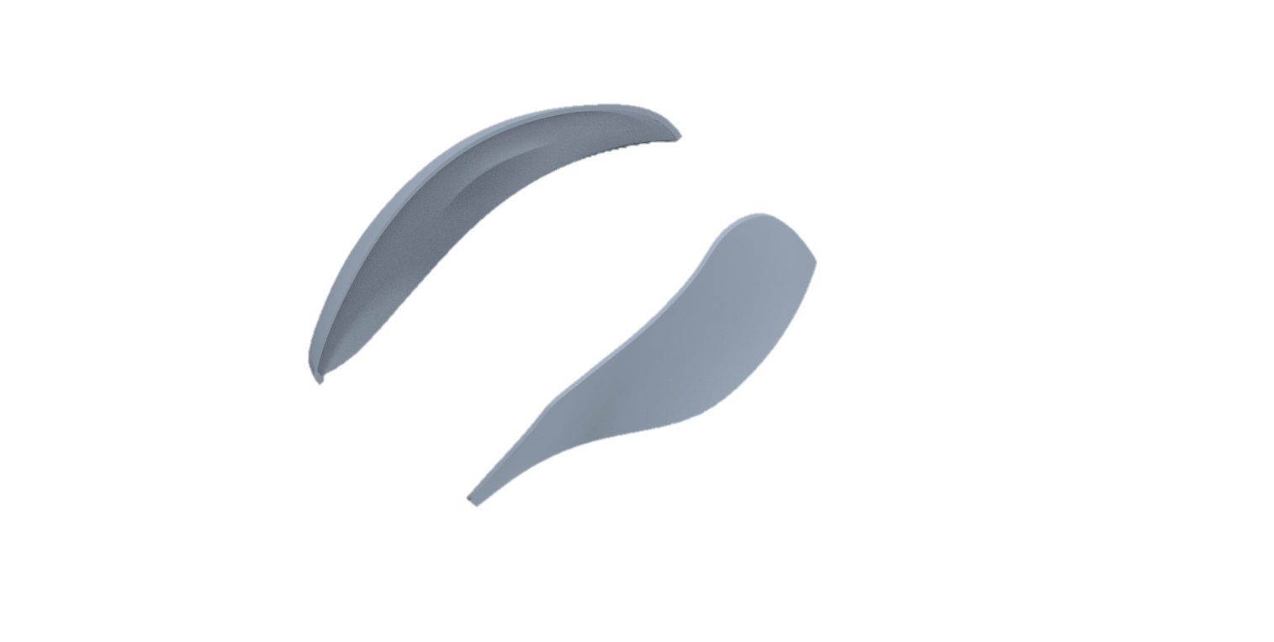
Università di Bologna
MOUSE LOGITECH M705
Dipartimento di Ingegneria Industriale
an assignment of Computer Aided Design Laboratory M
Modelling steps
Further partitions
Partition of top side to obtain three pieces:
The top side (including mouse keys)
The main-top side (structural)
The lateral strip (bracket of lateral buttons)
Further partition of the upper side obtained previously
Boolean operations
Modelling strategy

Slide 10
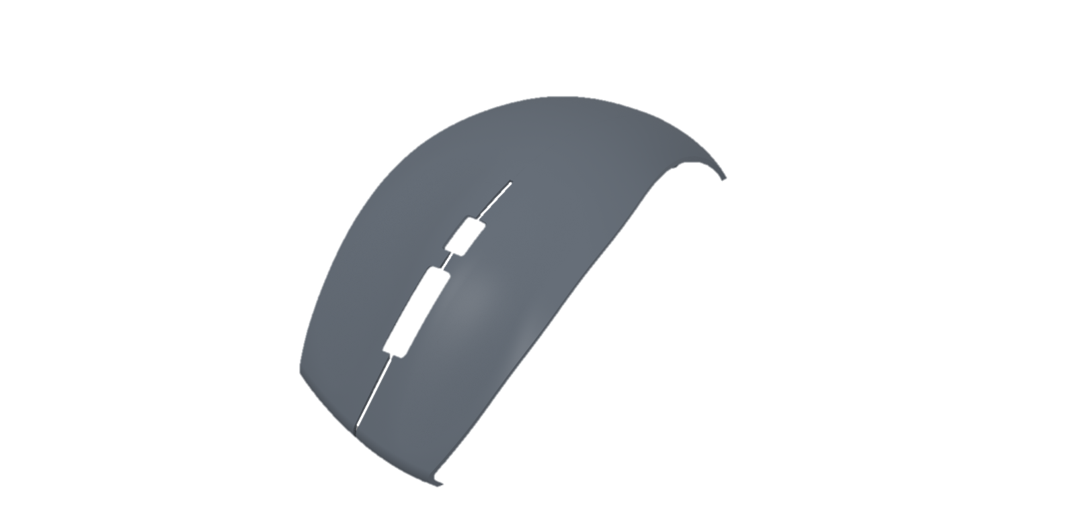
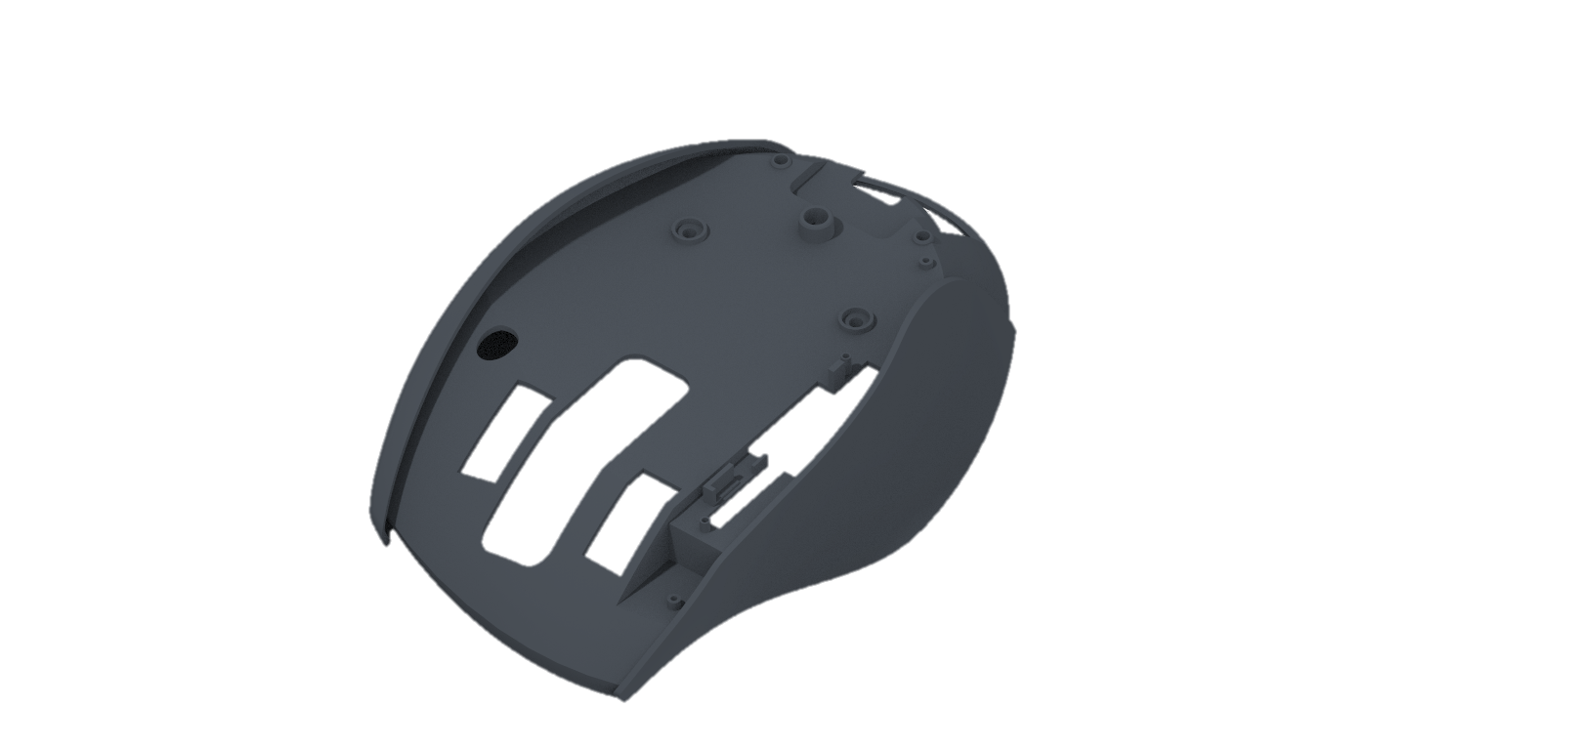
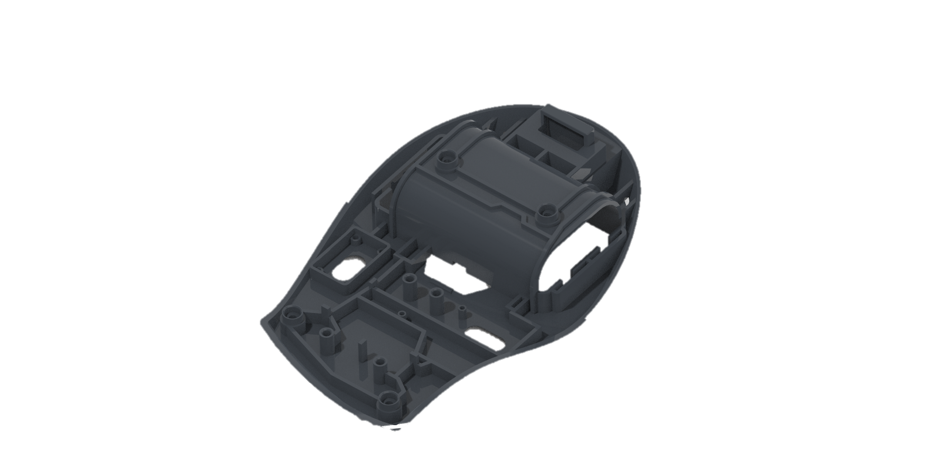
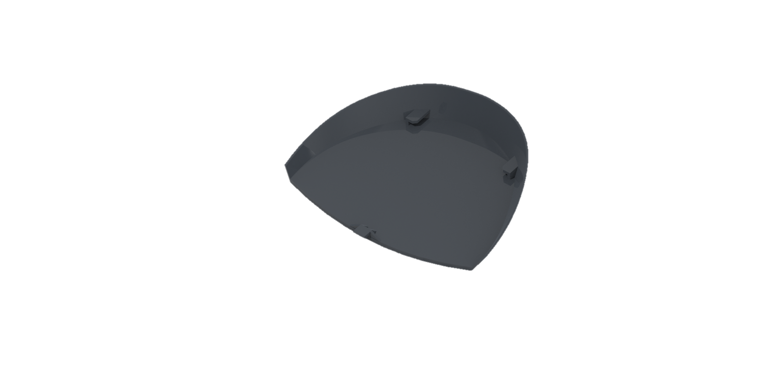
Università di Bologna
MOUSE LOGITECH M705
Dipartimento di Ingegneria Industriale
an assignment of Computer Aided Design Laboratory M
Modelling steps
Detailed modelling of parts
Development of every part previously obtained, for example, the battery case, the supports for the motherboard, the hole of the upper button...
Some parts developed
The bottom and the main upper are the most developed
Modelling strategy

Slide 11
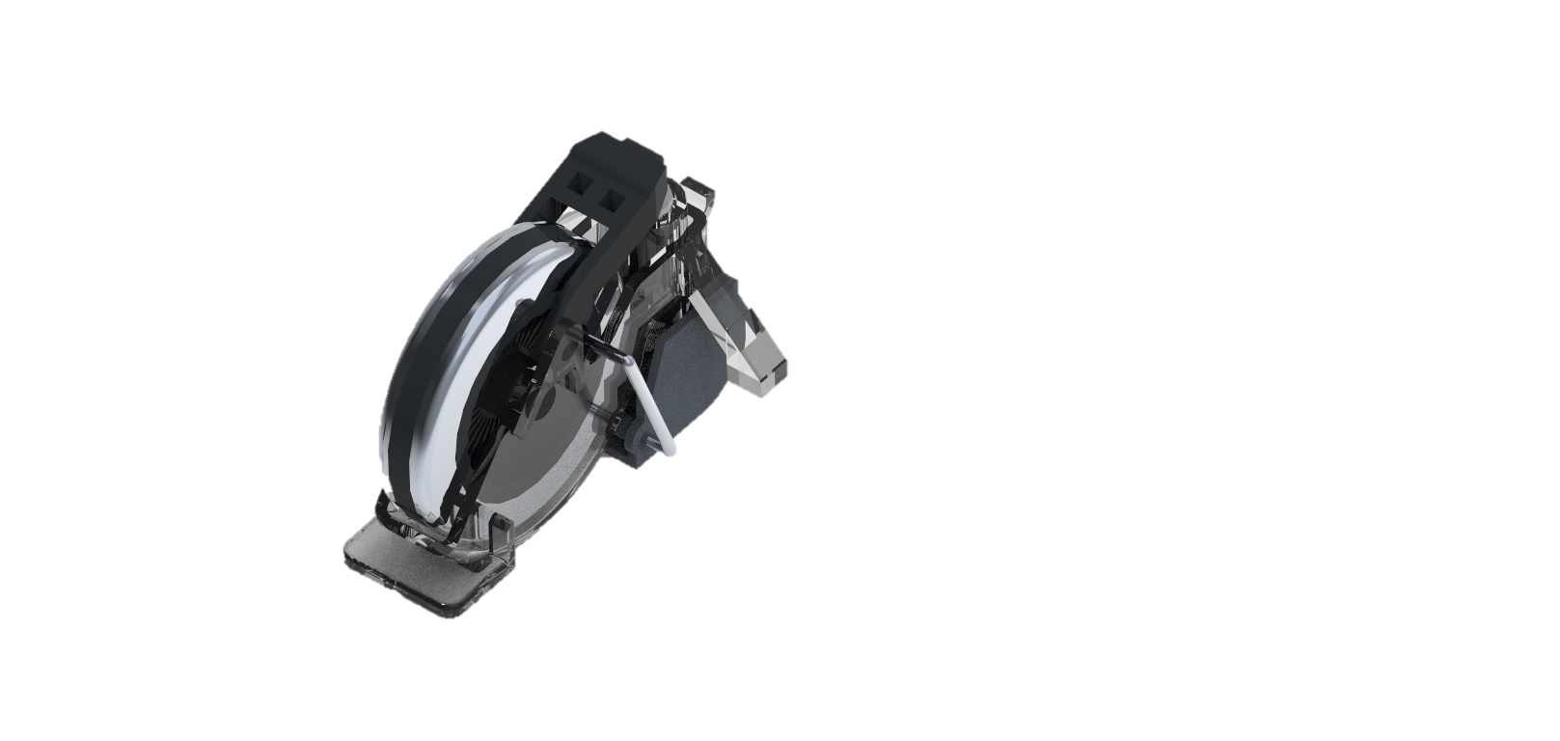
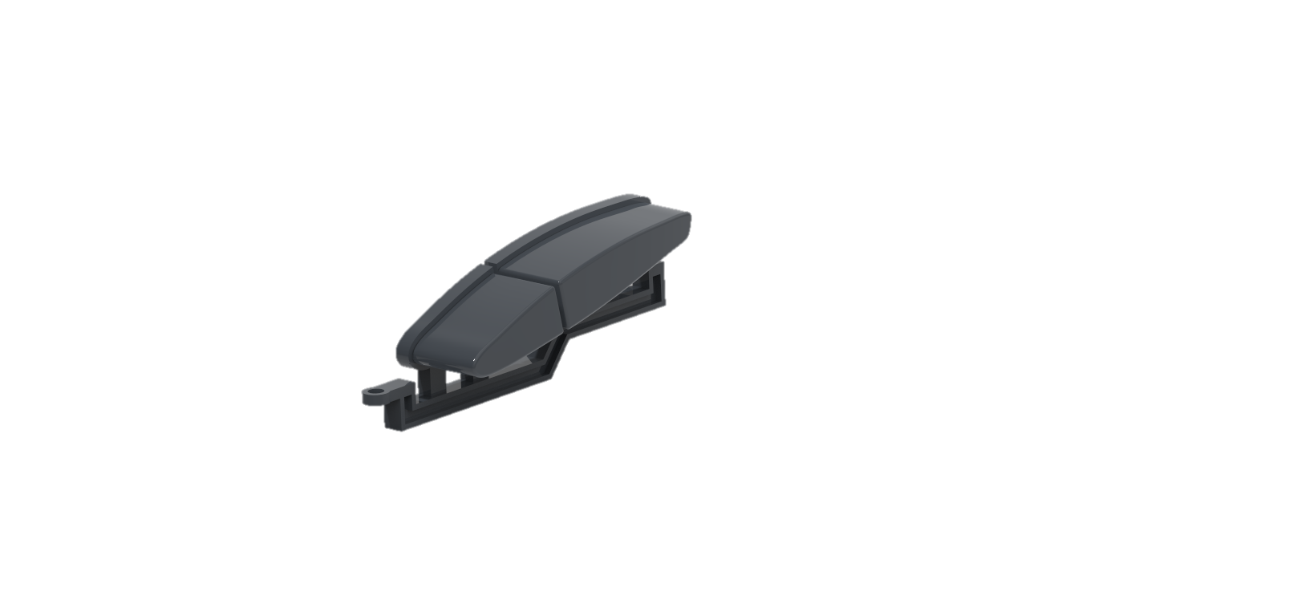
Università di Bologna
MOUSE LOGITECH M705
Dipartimento di Ingegneria Industriale
an assignment of Computer Aided Design Laboratory M
Modelling steps
Additional components
Adding other components that guarantee the complete functionality of the mouse.
Adding the editable buttons
The five buttons are included in the movements of the mouse wheel and in the lateral keys
Modelling strategy

Slide 12
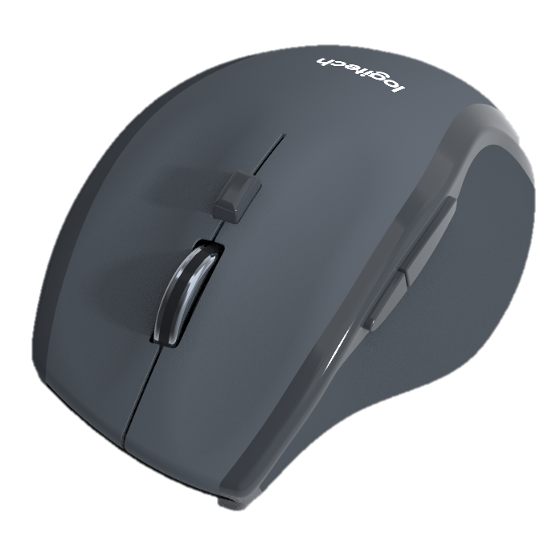
Università di Bologna
MOUSE LOGITECH M705
Dipartimento di Ingegneria Industriale
an assignment of Computer Aided Design Laboratory M
Modelling steps
Export rendered images
The last step of the modeling strategy consists of working on the assembly’s appearance, in order to exporting rendered images
Modelling strategy

Slide 13
Università di Bologna
MOUSE LOGITECH M705
Dipartimento di Ingegneria Industriale
an assignment of Computer Aided Design Laboratory M
Blueprints
Sketch
Boundary blend
Solidify
The blueprints and images of the mouse are the main support to start sketching
Sketches are fundamental to obtaining the references requested by the boundary blend feature
The boundary blend feature creates surfaces from curves and sketches defined in two directions
Joining more blended surfaces in a single closed one allows to obtain a solidified object
Monoblock modelling
The modeling of the first single monoblock is the most time-consuming step of the process but improve the accuracy of the final object's shape

Slide 14
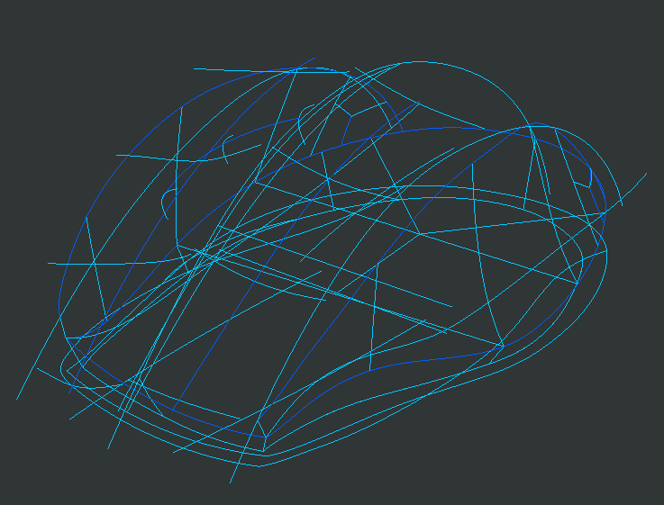
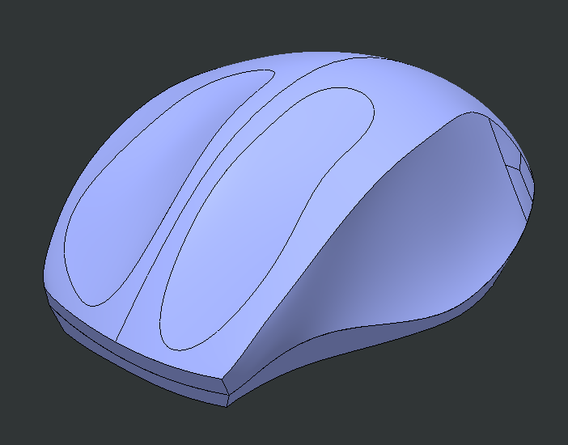
Università di Bologna
MOUSE LOGITECH M705
Dipartimento di Ingegneria Industriale
an assignment of Computer Aided Design Laboratory M
Getting real surfaces
The grid of curves on which the blended surfaces are formed is obtained with the intersection feature: each curve is the intersection of two sketches on orthogonal planes. This procedure allows to obtain surfaces coinciding with the boundaries of the blueprints.
Monoblock modelling

Slide 15
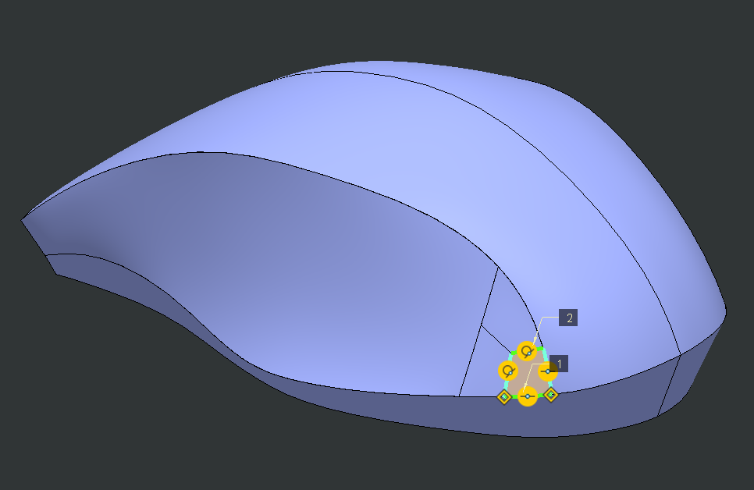
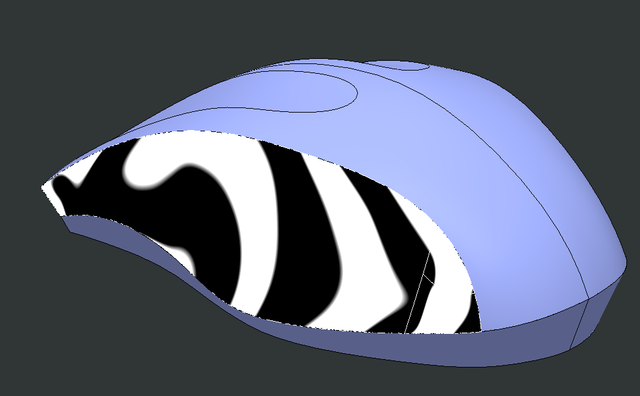
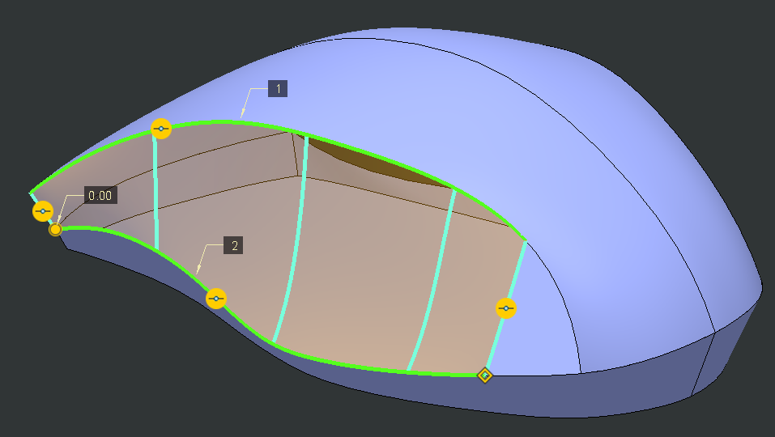
Università di Bologna
MOUSE LOGITECH M705
Dipartimento di Ingegneria Industriale
an assignment of Computer Aided Design Laboratory M
Points of singularity
Each side face has edges coinciding at a singularity point, which cannot be modeled correctly with a single blend surface. To close the surface, three quadrangular patches are used with continuity and curvature constraints on the previous surface
Monoblock modelling

Slide 16
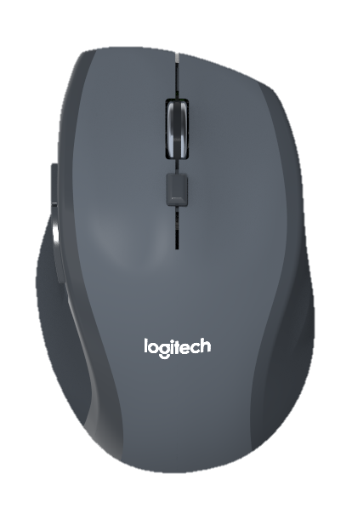
Università di Bologna
MOUSE LOGITECH M705
Dipartimento di Ingegneria Industriale
an assignment of Computer Aided Design Laboratory M
Original
Assignment X
The original one has a shape which follows the natural curve of hand to improve comfort
The CAD model mimic the original one even in the appeareances
Model comparison
The final assembly is quite similar to the original mouse thanks to the strategy we used

Slide 17
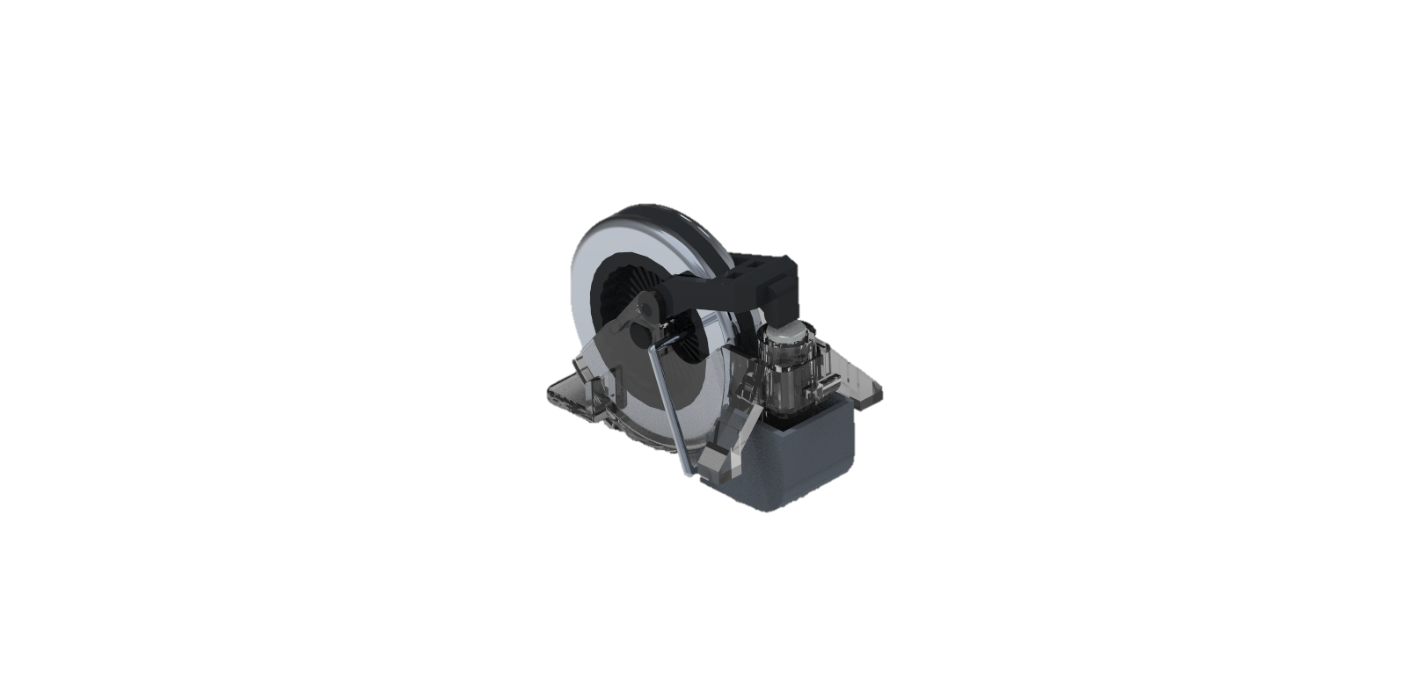
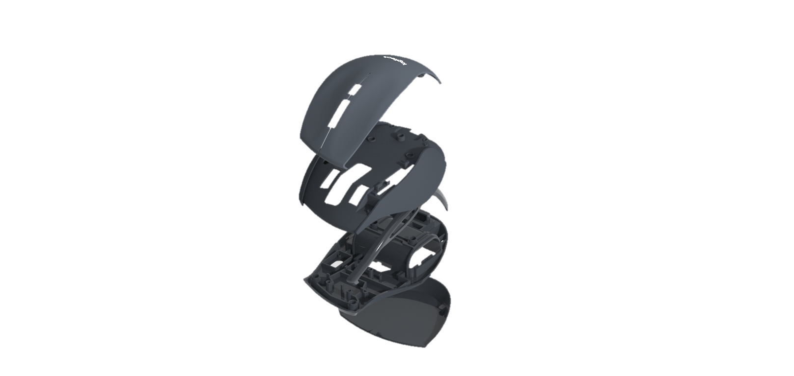
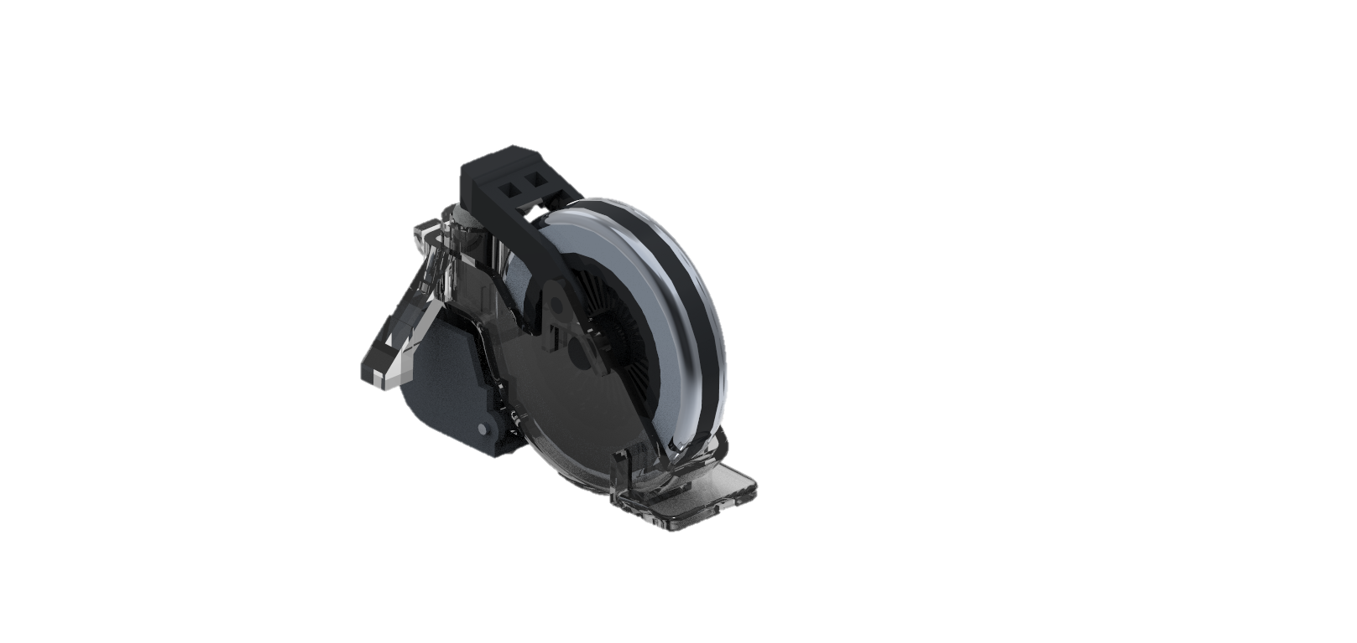
Università di Bologna
MOUSE LOGITECH M705
Dipartimento di Ingegneria Industriale
an assignment of Computer Aided Design Laboratory M
Exploded view
The mouse wheel
The internal parts were modeled following a careful research for disassembled parts
Tthe hyper-fast scrolling brings a mechanism similar to the click pen's one
Model details
The final assembly is quite similar to the original mouse thanks to the strategy we used

Slide 18
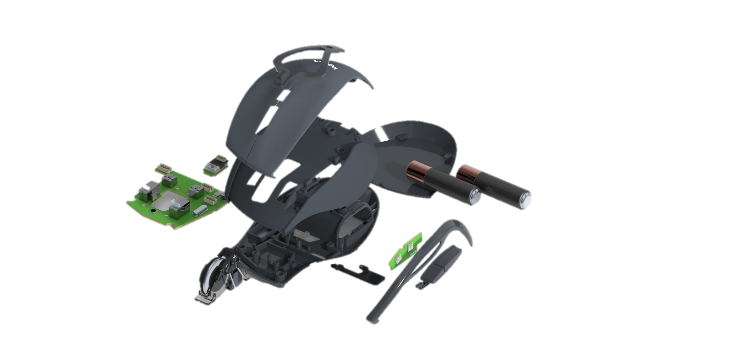
Università di Bologna
MOUSE LOGITECH M705
Dipartimento di Ingegneria Industriale
an assignment of Computer Aided Design Laboratory M
Complete exploded view
A mouse contains more parts than you think (some were not represented)

